Slide 1
INTRODUCTION TO DATABASES--
DBMS-1002

Slide 2
What we will learn...
What is: a Database, a DBMS, a Flat File.
What is a Table? Row? Column?
What are the differences between simple/composite and stored/derived attributes?
What is a datatype?
How do we interact with a database from an application?
Notes:
Students should be encouraged to copy this slide into Word and answer the questions as the lecture progresses.

Slide 3
Welcome!
We are learning about managing data through databases.
To do this, we will be learning a Database Management System (DBMS).
Our DBMS uses a specific kind of model to do this called a: Relational Database Model
Notes:
This is a good site to learn a little more history of databases. https://www.PostgreSQL.com/ca-en/database/what-is-database.html

Slide 4
Welcome!
A good database definition comes from the Oracle Corporation...
“An organized collection of structured information, or data, typically stored electronically in a computer system.”
A DBMS is a software package that allows us work with data in our database.
The DBMS that we will use in this course is PostgreSQL
This is a good site to learn a little more history of PostgreSQL. https://www.postgresql.org/about/

Slide 5
Relational Database Model
Definition
A relational database is a database structured to recognize relations among stored items of information
In this model, information is stored as simple rows and columns in tables of data (much like Excel!)
Queries make it easy to insert, delete, update, filter and sort records of data

Slide 6
Other Database Models
Although there are many other types of database models out there, we will not be covering them in this class
A popular alternative to be aware of is the Document Object-based Model
Used by MongoDB and is often referred to as NoSQL

Slide 7
What is a Database?
Remember a DBMS is a computer application that is installed on a computer
A computer with a running DBMS is called a Server
A server receives and sends data to other applications:
Between computers over a network
Between applications on the same computer
We will not be using a remote server in this course.

Slide 8
Database Tables
Offices
Office City Region Manager 22 Denver Western 108 11 New York Eastern 106
12 Chicago Eastern 104 13 Atlanta Eastern 105 21 Los Angeles Western 108
Definition
A table has a name and contains rows and columns
Example (Office table)
Each row of the office table represents a single office
Each column describes one detail of an office:
Ex: The Manager column represents the ID of employee who manages this Office
A Column can also be called an Attribute or a Field
A Row is also called a Record
Notes:
rows aka tuple, record
columns aka fields, attributes

Slide 9
Tables ( Entities )
Each table must have at least one column (attribute)
A table can have zero or more rows (records)
The number of rows is limited by the storage space on the computer hosting the database!
Column order from left to right is defined when the table is first created
We will create our own tables later!
Tables can also be referred to as: Entities

Slide 10
Columns( Attributes )
A Column is also called an: Attribute or Field
A collection of attributes define the Entity (table)
Ex: Student entity with 4 attributes: StudentID, Name, Birthday, Address
Attribute values can be:
Simple or Composite
Stored or Derived
A specific datatype value
NULL

Slide 11
Simple and Composite Attributes
Simple Attribute
The attribute value is not divisible into anything smaller.
Ex: First Name, Year, Age, SIN, StudentID, etc

Slide 12
Simple and Composite Attributes
Composite Attribute
The attribute’s value can be divided into subparts with their own meaning.
Ex: FullName contains both a first and last name
Ex: BirthDate may consist of Day, Month, and Year
By themselves, this data is not all that useful, so they are normally stored together.

Slide 13
Stored and Derived Attributes
Stored Attribute
This is the default type of attribute. When there is no way to ‘calculate’ the value, using other attributes in the database.
Ex: BirthDate
You either know someone’s birthday or you do not. Other than guessing, you cannot derive someone’s birthday.

Slide 14
Stored and Derived Attributes
Derived attribute
Can be calculated from other attributes in the database.
Ex: Age
Can be derived using the formula: Age = Today – BirthDate
Ex: NumberOfStudents Can be derived by counting the Student table’s rows

Slide 15
Datatype Values
Attributes are restricted to a specific datatype value, defined at the time of the table creation.
Note: If you already have some programming experience, this is similar to when you declare a variable.
Ex: int, double, string, boolean, etc

Slide 16
Datatype Values - Numbers
Numbers
Ex: Age
May contain decimals
No letters or special characters allowed
In PostgreSQL this is a: NUMERIC datatype

Slide 17
Datatype Values - Dates
Dates
Ex: Birthdate
Contains a day, month and year
May even contain hours, minutes, seconds
In PostgreSQL this is either a: DATE or TIMESTAMP datatype

Slide 18
Datatype Values - Strings
Strings and Characters
Ex: First Name
A series of characters
Can be any combination of numbers, symbols and letters
In PostgreSQL this is a: VARCHAR datatype
NOTE: STRING is not considered a valid SQL TYPE

Slide 19
Datatype Values
Datatype names differ between databases
Microsoft SQL Server, MySql, PostGres and others may differ in the naming of datatypes.
We will be learning about datatypes in more detail later in the course. Here’s a link to all the PostgreSQL Datatypes if you’re interested: https://www.postgresql.org/docs/current/datatype.html

Slide 20
NULL Values
Sometimes we do not have a value,
NULL values mean: ‘there is no value here’.
The field is empty.
NOTE:
Nulls are NOT the same as a zero or a space
Null literally means there is nothing stored for this attribute

Slide 21
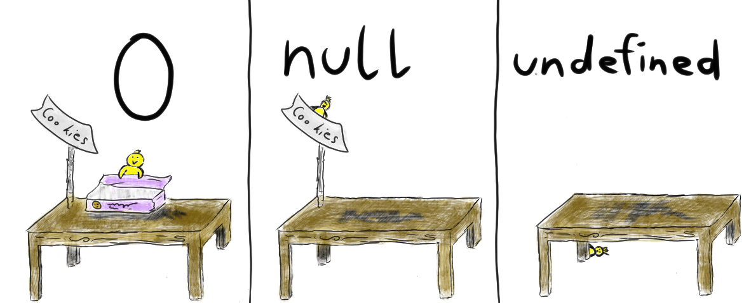
NULL Values

Slide 22
NULL Values
NULL values happen for a variety of reasons:
A Value exists, but is not currently known
Example: Birthdate
Everyone has one, but we don’t know it right now
A Value may not exist at all
Example: HomePhone
How many of you have a landline?

Slide 23
Why Not A Flat File Database?
Most of us are familiar with Excel already.
Excel and similar data storage files are called: Flat Files
Other examples of flat files you may know about: XML, JSON, CSV (comma-separated values), and simple text files
Flat files have no hierarchical design and are often stored as values separated by symbols
These types of files are still extremely useful, data is often sent between web pages in these formats
Comma-Separated Values Example: 6777686, Scott, Wachal, 21

Slide 24
Why Not A Flat File Database?
So why not use a flat file as a database?
We can!
A lot of smaller businesses continue to do so today!
However, they have their own issues . . .

Slide 25
Why Not A Flat File Database?
Disadvantages of flat files:
Only one person can edit a file at one time
Duplicate data
Inconsistent data
Letters might be entered for someone’s age
Lack of data protection
Deleting or moving data accidentally
So what makes a relational DBMS better?

Slide 26
Database Advantages
Advantages of a well-designed relational database:
The ability to handle huge volumes of data and multiple concurrent users.
Maintains data integrity, consistency, security, and appreciable system performance.
Reduced data redundancy (duplication)
Reduced data entry, storage and retrieval costs

Slide 27
Relational Databases - Primary Keys
PostgreSQL is the relational DBMS we will be using exclusively for this course.
Relational databases use Keys to identify each row in a table and to link rows between tables.
Before we continue, let’s talk a little bit about how these keys work!

Slide 28
Primary Keys (PK)
Primary Key: a column (attribute) which uniquely identifies a single row in a table. Can also be a combination of two or more columns, in this case called Composite Primary Key.
To be considered a Primary Key:
The column(s) cannot be null
Must be a unique value (cannot repeat) within the table
The value in the column should never change over time
Can you think of some real life Primary Key examples?
Notes:
Primary Key examples: SIN, Driver’s License, Student Number, ISBN

Slide 29
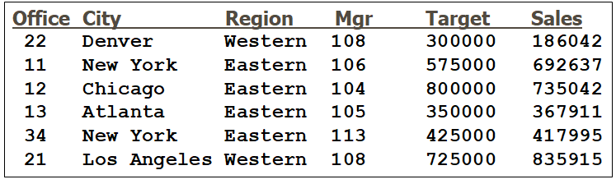
Primary Keys (PK)
Using the above table as an example, which column would make for the best Primary Key?
Notes:
Office, because it is unique!

Slide 30
Primary Keys (PK)
Using the above table as an example, which column would make for the best Primary Key? Office!
Cities can have the same name (Ex: Springfield). Many cities exist in the same region. Managers can manage many offices. Target and Sales are both values that change over time!
Notes:
Office, because it is unique!

Slide 31
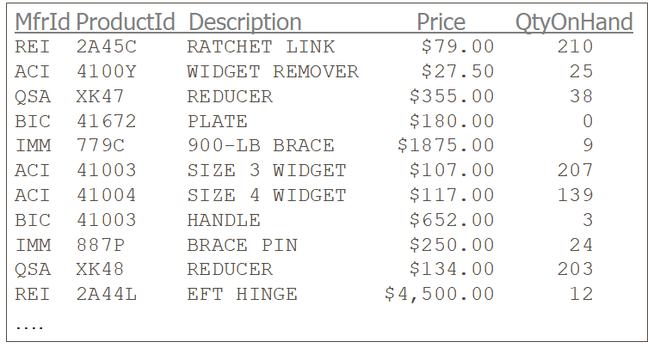
Primary Keys (PK)
What about this one? Which column would make for the best Primary Key?
Notes:
Composite!

Slide 32
Primary Keys (PK)
MfrID: Has duplicates! ProductID: Has duplicates! Description: Can have duplicates. Price: This is a terrible idea, how many items might be priced the same? QtyOnHand: Again, a terrible idea, inventory changes over time!
Notes:
Composite!

Slide 33
Primary Keys (PK)
We need a Composite Primary Key!
Remember we can declare more than one column the primary key.
This would mean that the combination of MfrID and ProductID together would make up a unique set of values for one row.
Notes:
Composite!

Slide 34
Primary Keys (PK) - Surrogate Keys
Definition:
A Surrogate Key is a column (attribute) which is created specifically for a table to be the Primary Key.
When this happens the value is often auto-generated and each new value is calculated by the system automatically.
Numbers and date time stamps are usually good options for surrogate key values.

Slide 35
Primary Keys (PK)
item_id
1
2
3
4
5
6
7
8
9
10
11
….
Another option is a Surrogate Primary Key!

Slide 36
Surrogate Keys - Pros vs Cons
Pros:
Simplifies the data (removes composite keys)
No chance for human error if the value is auto-generated
Cons:
Extra storage (new column added)
Processing time and logic required to pick the next value.
The value is often meaningless to read (this can also be a pro, as it helps with security!)

Slide 37
Table Relationships
Tables rarely exist on their own.
Relationships are expressed as Parent - Child.
A Parent (table) can have zero or more children.
A Child (table) can have 1 or more parents.
Consider Employees and Departments:
An Employee can work in a single department.
A Department can have many Employees working in it.

Slide 38
Table Relationships
Employees
Departments
EMPLOYEE_ID FIRST_NAME LAST_NAME DEPARTMENT_ID
----------- ---------- ---------- -------------
198 Donald OConnell 50
199 Douglas Grant 50
200 Jennifer Whalen 10
201 Michael Hartstein 20
202 Pat Fay 20
203 Susan Mavris 40
204 Hermann Baer 70
DEPARTMENT_ID DEPARTMENT_NAME
------------- ---------------
10 Administration
20 Marketing
30 Purchasing
40 Human Resources
50 Shipping
60 IT
70 Public Relation
First, let us identify the keys:
The Primary Key of Employees is: Employee_ID
The Primary Key of Departments is: Department_ID

Slide 39
Table Relationships
Employees
Departments
EMPLOYEE_ID FIRST_NAME LAST_NAME DEPARTMENT_ID
----------- ---------- ---------- -------------
198 Donald OConnell 50
199 Douglas Grant 50
200 Jennifer Whalen 10
201 Michael Hartstein 20
202 Pat Fay 20
203 Susan Mavris 40
204 Hermann Baer 70
DEPARTMENT_ID DEPARTMENT_NAME
------------- ---------------
10 Administration
20 Marketing
30 Purchasing
40 Human Resources
50 Shipping
60 IT
70 Public Relation
A relationship is formed when a Primary Key from one table exists on another table!
In this case: Employees has a department_id
This is called a FOREIGN KEY!

Slide 40
Foreign Keys (FK)
Definition:
A Foreign Key is a column whose values (and datatype) match the primary key of another table.
By default, foreign key values may contain duplicates and may be NULL. (when we create table later, we will discuss this further)
If the Primary key is composite (contains 2 or more columns), the foreign key must also be composite.

Slide 41
Table Relationships
Employees
Departments
EMPLOYEE_ID FIRST_NAME LAST_NAME DEPARTMENT_ID
----------- ---------- ---------- -------------
198 Donald OConnell 50
199 Douglas Grant 50
200 Jennifer Whalen 10
201 Michael Hartstein 20
202 Pat Fay 20
203 Susan Mavris 40
204 Hermann Baer 70
DEPARTMENT_ID DEPARTMENT_NAME
------------- ---------------
10 Administration
20 Marketing
30 Purchasing
40 Human Resources
50 Shipping
60 IT
70 Public Relation
So, how do you know if there is a Parent - Child relationship?
We see the Primary key exists in both tables: Department_ID
Note: Although the column names are the same in this example, they could be named differently.
Notes:
We will discuss how to spot foreign keys that are named differently when we cover ERDs

Slide 42
Table Relationships - Parent
Employees
Departments
EMPLOYEE_ID FIRST_NAME LAST_NAME DEPARTMENT_ID
----------- ---------- ---------- -------------
198 Donald OConnell 50
199 Douglas Grant 50
200 Jennifer Whalen 10
201 Michael Hartstein 20
202 Pat Fay 20
203 Susan Mavris 40
204 Hermann Baer 70
DEPARTMENT_ID DEPARTMENT_NAME
------------- ---------------
10 Administration
20 Marketing
30 Purchasing
40 Human Resources
50 Shipping
60 IT
70 Public Relation
The Parent is the table whose Primary key is being used on another table.
In this case Departments is the Parent of Employees.

Slide 43
Table Relationships - Child
Employees
Departments
EMPLOYEE_ID FIRST_NAME LAST_NAME DEPARTMENT_ID
----------- ---------- ---------- -------------
198 Donald OConnell 50
199 Douglas Grant 50
200 Jennifer Whalen 10
201 Michael Hartstein 20
202 Pat Fay 20
203 Susan Mavris 40
204 Hermann Baer 70
DEPARTMENT_ID DEPARTMENT_NAME
------------- ---------------
10 Administration
20 Marketing
30 Purchasing
40 Human Resources
50 Shipping
60 IT
70 Public Relation
The Child is the table who references another table’s Primary key.
In this case Employees is the Child of Departments.
Notes:
Which Employee works for Human Resources??

Slide 44
Table Relationships - Child
Employees
Departments
EMPLOYEE_ID FIRST_NAME LAST_NAME DEPARTMENT_ID
----------- ---------- ---------- -------------
198 Donald OConnell 50
199 Douglas Grant 50
200 Jennifer Whalen 10
201 Michael Hartstein 20
202 Pat Fay NULL
203 Susan Mavris 40
204 Hermann Baer 70
DEPARTMENT_ID DEPARTMENT_NAME
------------- ---------------
10 Administration
20 Marketing
30 Purchasing
40 Human Resources
50 Shipping
60 IT
70 Public Relation
Which employee works in human resources?
Susan Marvis, because her department id is 40, which matches the department id of Human Resources!
Notes:
What does the NULL mean for Pat Fay?

Slide 45
Table Relationships - Child
Employees
Departments
EMPLOYEE_ID FIRST_NAME LAST_NAME DEPARTMENT_ID
----------- ---------- ---------- -------------
198 Donald OConnell 50
199 Douglas Grant 50
200 Jennifer Whalen 10
201 Michael Hartstein 20
202 Pat Fay NULL
203 Susan Mavris 40
204 Hermann Baer 70
DEPARTMENT_ID DEPARTMENT_NAME
------------- ---------------
10 Administration
20 Marketing
30 Purchasing
40 Human Resources
50 Shipping
60 IT
70 Public Relation
What does that NULL mean for Pat Fay?
Pat Fay has not been assigned to a department.

Slide 46
How do we interact with PostgreSQL DB?
We know what a database does and some important aspects of tables and rows.
We know why it is better than a flat file! But, HOW do we use it!? We need an Integrated Development Environment (IDE) such as: PostgreSQL.
PostgreSQL Benefits
Open source
Runs on all operating systems
Extensible
Follows SQL standard although there are some syntax differences

Slide 47
PostgreSQL
Follow the Instructions in the Applications and set up area in Learn to install PostgreSQL and run the startup file.
NOTE: If you wish to install this application again or on another computer, it has a free license and can be found at:
https://www.enterprisedb.com/downloads/postgres-postgresql-downloads

Slide 48
PostgreSQL
This script contains all the SQL code to create new tables and inserts example data.
You will learn how to write this code yourself by the time this semester ends!
Let’s take a quick peek at the Entity Relationship Diagram (ERD) of the database we just created!
Note: We do not need to understand the ERD yet, we will come back and cover this later on in the course!
Just know there are table names and columns here!

Slide 49
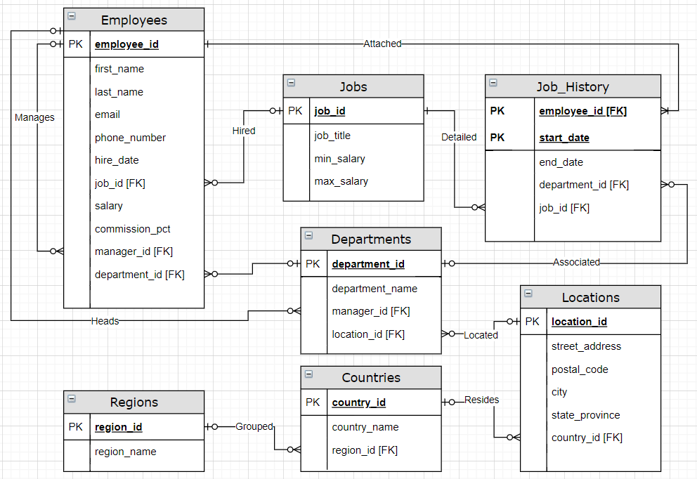
PostgreSQL HR Database (ERD)

Slide 50

TRY IT! PostgreSQL
Type this SQL code into the query editor:
Note: Spacing, tabs, and line breaks do not affect SQL
SELECT *
FROM Regions;
Highlight the line and press the play button

Slide 51
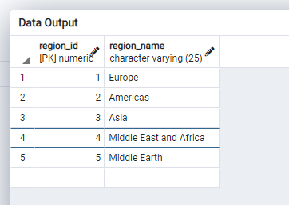
PostgreSQL - Script Output
The following results should be seen :

Slide 52

PostgreSQL – Saving the file
Save the file to a directory you will be using for this course
Use the file path to choose a location to save the file.
At the end of the path insert the file name.

Slide 53
Summary
What is: a Database, a DBMS, a Flat File.
What is a Table? Row? Column?
What are the differences between simple/composite and stored/derived attributes?
What is a datatype?
How do we interact with a database from an application?

Slide 54
Up Next . . .
We will be covering:
A brief history of SQL
DDL vs DML
Making basic queries with SELECT
Commenting SQL
Renaming columns

